Slide 1
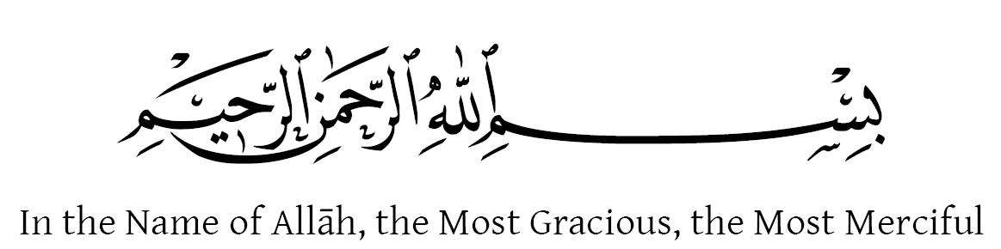


Slide 2

GREEN PAKISTAN
Supervised by:
Sir Rehan Tariq
Group Members:
Hamza Arshad (FA17-BCS-035)
Muhammad Hamza (FA17-BCS-113)
Department of Computer Science
COMSATS University Islamabad, Attock Campus

Slide 3
Outline
Introduction
Working flow
Problem statement
Objectives
Methodology
Modern tools
Benefits
References
_______________________________

Slide 4

Introduction
This android application is computerized version of plantation campaign and also has extra features in which people request for plants through their android mobile phone.
This application also provide the facility to view botanical information with pictures, benefits of plants, names and description, current location of user and green points and people will also remain up to dated with environmental changes.
People can view nearest green point on the map.
People can set the reminder for the watering of plants and also view weather of that day and next 5 days
_______________________________

Slide 5
Introduction (cont.…)
This application allows the users (volunteer) to complain to the ministry against deforestation or any kind of discrimination in plantation campaign.
People can view status of their plants request and also view status of complaint. Green points can add plants record ,

Slide 6
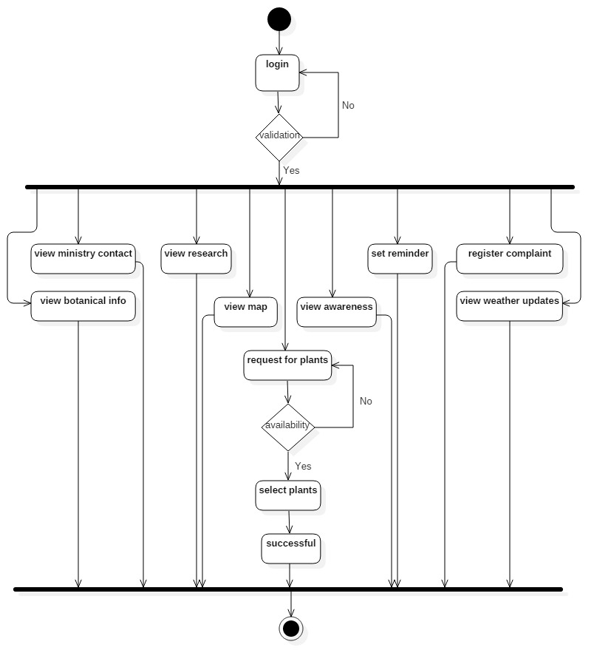
Working Flow

Slide 7
Problem statement
People of Pakistan did not know the process of availing plants from Green points because there was no option to inform people about starting and ending dates of plantation campaign.
This system was not keeping record of plants those were availed by people.
People could not complain against deforestation and green point secretly
Most of people did not know about suitable areas for plantation and the importance of plantation for environmental changes. People may be forgot the watering to plants
_______________________________

Slide 8
Objectives
By developing this application, we want to replace the manual system of plantation campaign into computerized system.
Realizing the people the importance of plants.
Educating people about plants, their medicinal and herbal properties.
Raising voice against deforestation through our app.
Keep the users update with weather.
Overcome on Global warming issue.
Enable the users to complain against green points if they found any kind of discrimination in plantation campaign.
_______________________________

Slide 9
Methodology
Sign up.
Login.
Forget password.
View google maps.
Request plants.
Add ,delete, update plant record.
Admin add and delete green points.
Register complaints.
View and response complaints.
_______________________________

Slide 10
Methodology (Cont.…)
Admin add ministry .
View contact details.
View research.
View weather updates.
Set reminders.
View awareness.
View botanical information.
_______________________________

Slide 11
Modern Tools
Software Requirements dependence:
IDE: Android Studio
Programming language: Java, XML
Database: Firebase
Tools: Android Studio
JDK
SDK
MS Word (Documentation)
MS Power Point (Presentation Work)
Hardware Requirements dependence:
Smart Mobile Phone: Android Studio

Slide 12
Benefits
It’s time saving process.
Easy to find green points location.
It will in still sense of community service in people.
Weather of our country would be more pleasant.
Pakistan would attract more tourists.
Prevention of deforestation.
_______________________________

Slide 13
References
"Pakistan (KPK)". Bonn Challenge. International Union for Conservation of Nature. Retrieved 28 October 2017.
^ "About Billion Tree Tsunami Afforestation Project". Government of Khyber Pakhtunkhwa. Retrieved 28 October 2017
https://en.wikipedia.org/wiki/Billion_Tree_Tsunami
https://www.iucn.org/theme/environmental-law#:~:text=IUCN%20aims%20to%20advance%20environmental,is%20equitable%20and%20ecologically%20sustainable.
_______________________________

